Slide 1
Module 2.4:
Passwords
Modeling how humans choose passwords
ML for Cybersecurity

Slide 2




Database Leaks of Passwords Are Common
https://haveibeenpwned.com/PwnedWebsites

Slide 3
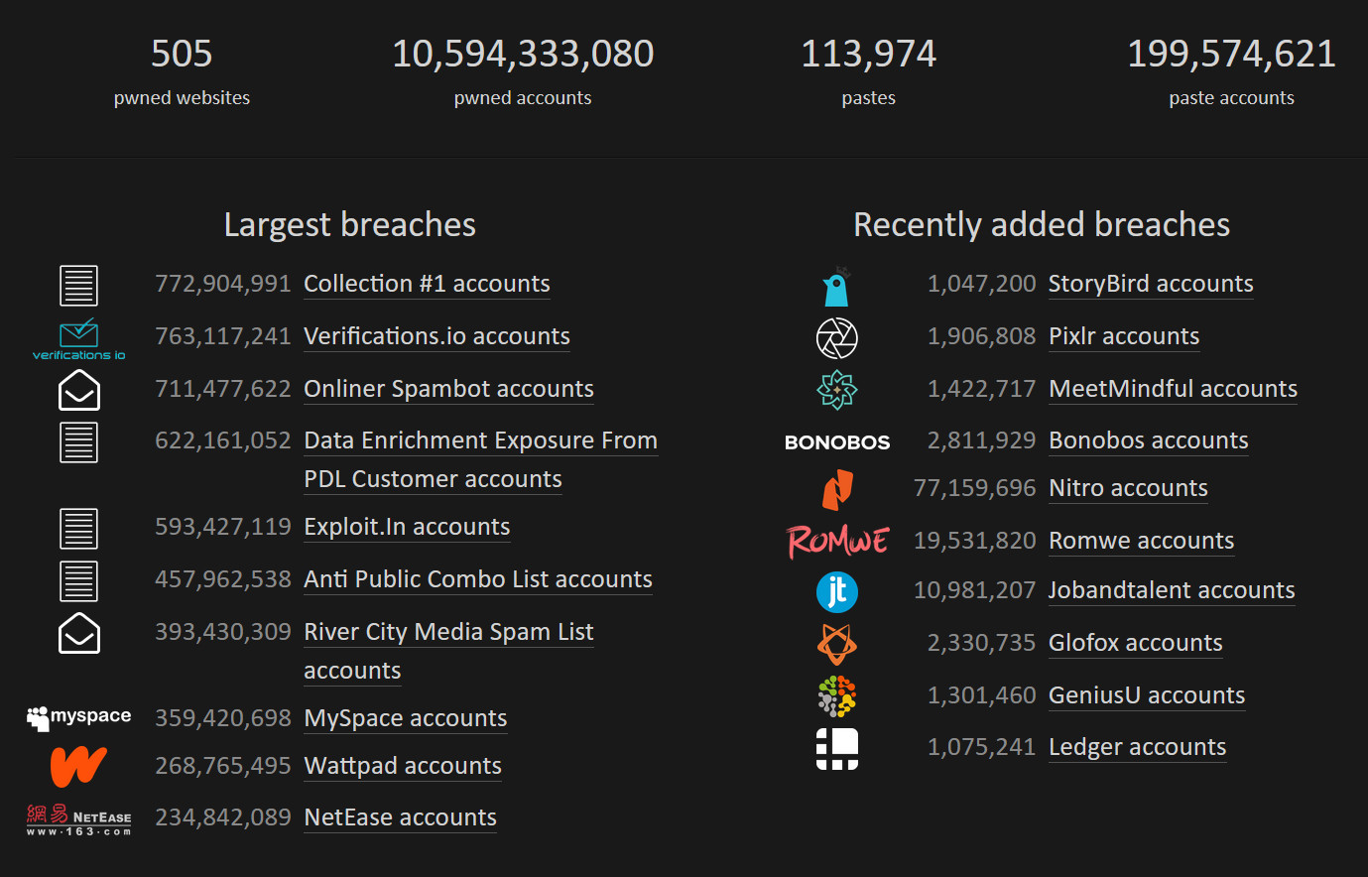
Database Leaks of Passwords Are Common
https://haveibeenpwned.com/PwnedWebsites

Slide 4
Database Leaks Enable Guessing

Slide 5
Attacking Passwords
Make guesses from the most probable to the least!
Online attack: Try logging into a running system until you are locked out
Offline attack: Make a guess and hash it

Slide 6


Offline Attacks
80d561388725fa74f2d03cd16e1d687c

Slide 7
Offline Attacks
80d561388725fa74f2d03cd16e1d687c
h(“123456”) = e10adc3949ba59abbe56e057f20f883e
h(“password”) = 5f4dcc3b5aa765d61d8327deb882cf99
h(“monkey”) = d0763edaa9d9bd2a9516280e9044d885
h(“letmein”) = 0d107d09f5bbe40cade3de5c71e9e9b7
h(“p@ssw0rd”) = 0f359740bd1cda994f8b55330c86d845

Slide 8
Offline Attacks
80d561388725fa74f2d03cd16e1d687c
h(“123456”) = e10adc3949ba59abbe56e057f20f883e
h(“password”) = 5f4dcc3b5aa765d61d8327deb882cf99
h(“monkey”) = d0763edaa9d9bd2a9516280e9044d885
h(“letmein”) = 0d107d09f5bbe40cade3de5c71e9e9b7
h(“p@ssw0rd”) = 0f359740bd1cda994f8b55330c86d845
h(“Chic4go”) = 80d561388725fa74f2d03cd16e1d687c

Slide 9
Offline Attacks
Attacker compromises database
Sees hashes like $2a$04$iHdEgkI681VdDMc3f7edau9phRwORvhYjqWAIb7hb4B5uFJO1g4zi
Attacker makes and hashes guesses
Finds match → try it on other sites (“credential stuffing” and “credential tweaking” attacks)
Password reuse is a core problem

Slide 10
Password-Strength Metric
Parameterized Guessability (“Guess Numbers”): How many guesses would a particular cracking algorithm with particular training data take to guess a password?
s3curityML!
Guess # 366,163,847,194

Slide 11
Password-Cracking MethodS

Slide 12
Broad Approaches to Cracking Passwords
Brute force (or selective brute force AKA “mask”)
Wordlist
Mangled Wordlist
Probabilistic Context-Free Grammar
Markov Models
Neural Networks

Slide 13
Broad Approaches to Cracking Passwords
Brute force (or selective brute force AKA “mask”)
Wordlist
Mangled Wordlist
Probabilistic Context-Free Grammar
Markov Models
Neural Networks

Slide 14
Broad Approaches to Cracking Passwords
Brute force (or selective brute force AKA “mask”)
Wordlist
Mangled Wordlist
Probabilistic Context-Free Grammar
Markov Models
Neural Networks

Slide 15
Broad Approaches to Cracking Passwords
Brute force (or selective brute force AKA “mask”)
Wordlist
Mangled Wordlist
Probabilistic Context-Free Grammar
Markov Models
Neural Networks

Slide 16
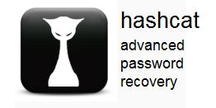

Mangled Wordlist Attack
Wordlist
Rulelist
Guesses
MLClass
Password
Chicago
Append “1”
Replace “a” → “4”
Lowercase all

Slide 17
Mangled Wordlist Attack
Wordlist
Rulelist
Guesses
MLClass
Password
Chicago
Append “1”
Replace “a” → “4”
Lowercase all
MLClass1
Password1
Chicago1

Slide 18
Mangled Wordlist Attack
Wordlist
Rulelist
Guesses
MLClass
Password
Chicago
Append “1”
Replace “a” → “4”
Lowercase all
MLClass1
Password1
Chicago1
MLCl4ss
P4ssword
Chic4go

Slide 19
Mangled Wordlist Attack
Wordlist
Rulelist
Guesses
MLClass
Password
Chicago
Append “1”
Replace “a” → “4”
Lowercase all
MLClass1
Password1
Chicago1
MLCl4ss
P4ssword
Chic4go
mlclass
password
chicago

Slide 20
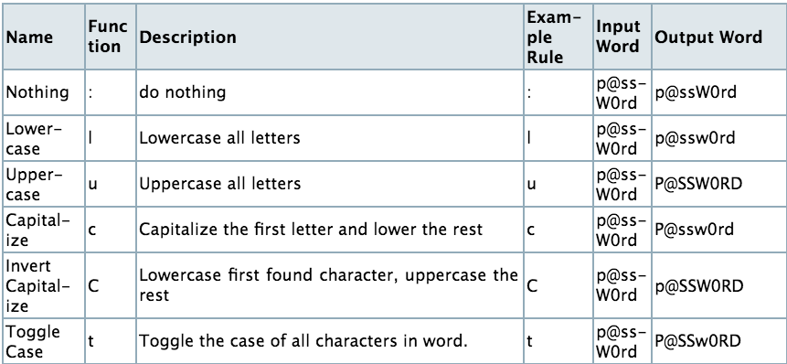
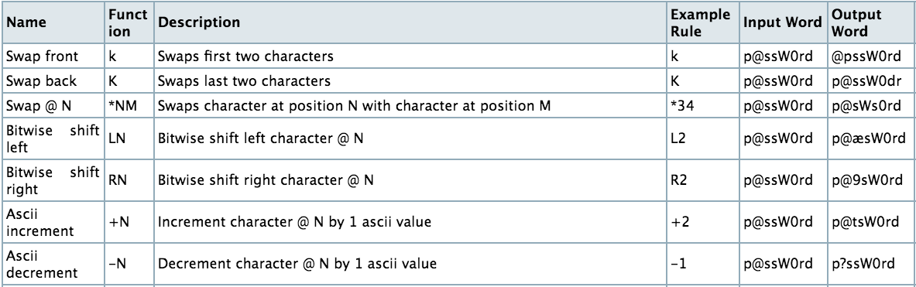
Mangled Wordlist Attack: Rule Language

Slide 21
Broad Approaches to Cracking Passwords
Brute force (or selective brute force AKA “mask”)
Wordlist
Mangled Wordlist
Probabilistic Context-Free Grammar
Markov Models
Neural Networks

Slide 22
Probabilistic Context-Free Grammar
chic4gooo

Slide 23
Probabilistic Context-Free Grammar
chic4gooo
Structure model:
L₄D₁L₄ (100% probability)

Slide 24
Probabilistic Context-Free Grammar
chic4gooo
Structure model:
L₄D₁L₄ (100% probability)
Letter model:
L₄ ➔ chic (50% probability), gooo (50% probability)

Slide 25
Probabilistic Context-Free Grammar
chic4gooo
Structure model:
L₄D₁L₄ (100% probability)
Letter model:
L₄ ➔ chic (50% probability), gooo (50% probability)
Digit model:
D₁ ➔ 4 (100% probability)

Slide 26
Probabilistic Context-Free Grammar
chic4gooo
Probability of a password:
Product of the probability of the structure and probabilities of strings

Slide 27
Broad Approaches to Cracking Passwords
Brute force (or selective brute force AKA “mask”)
Wordlist
Mangled Wordlist
Probabilistic Context-Free Grammar
Markov Models
Neural Networks

Slide 28
Markov Models
chic4gooo
2-gram model:

Slide 29
Markov Models
chic4gooo
2-gram model:
[start] ➔ c (100%)
4 ➔ g (100%)
c ➔ h (50%), 4 (50%)
g ➔ o (100%)
h ➔ i (100%)
i ➔ c (100%)
o ➔ o (67%) [end] (33%)

Slide 30
Markov Models
chic4gooo
2-gram model:
[start] ➔ c (100%)
4 ➔ g (100%)
c ➔ h (50%), 4 (50%)
g ➔ o (100%)
h ➔ i (100%)
i ➔ c (100%)
o ➔ o (67%) [end] (33%)

Slide 31
Markov Models
chic4gooo
2-gram model:
[start] ➔ c (100%)
4 ➔ g (100%)
c ➔ h (50%), 4 (50%)
g ➔ o (100%)
h ➔ i (100%)
i ➔ c (100%)
o ➔ o (67%) [end] (33%)

Slide 32
Markov Models
chic4gooo
Probability of a password:
Product of all characters’ probabilities
2-gram model:
[start] ➔ c (100%)
4 ➔ g (100%)
c ➔ h (50%), 4 (50%)
g ➔ o (100%)
h ➔ i (100%)
i ➔ c (100%)
o ➔ o (67%) [end] (33%)

Slide 33
Broad Approaches to Cracking Passwords
Brute force (or selective brute force AKA “mask”)
Wordlist
Mangled Wordlist
Probabilistic Context-Free Grammar
Markov Models
Neural Networks

Slide 34
Neural Network
chic4gooo
Probability of a password:
Product of all characters’ probabilities
p(“c”|“”) = ?
p(“h”|“c”) = ?
p(“i”|“ch”) = ?
p(“c”|“chi”) = ?
p(“4”|“chic”) = ?
p(“g”|“chic4”) = ?
…

Slide 35
Neural Network Design Space
RNN (Recurrent Neural Network)
LSTM (Long Short-Term Memory)
Model size: 3mb (browser) vs. 60mb (GPU)
Transfer learning
Novel password-composition policies
Training data
Natural language
William Melicher, Blase Ur, Sean M. Segreti, Saranga Komanduri, Lujo Bauer, Nicolas Christin, Lorrie Faith Cranor. Fast, Lean, and Accurate: Modeling Password Guessability Using Neural Networks. In Proc. USENIX Security Symposium, 2016.

Slide 36
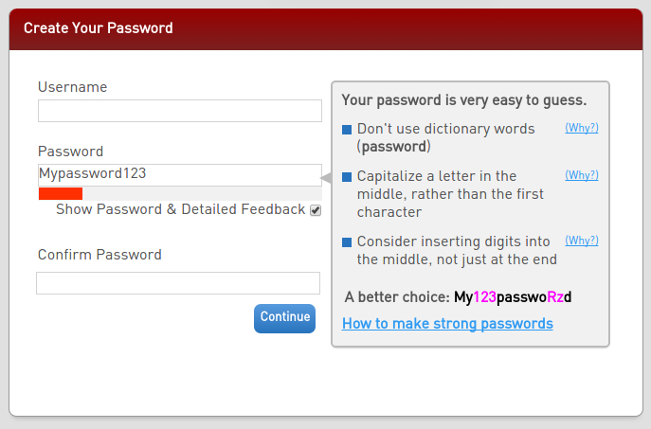
A Data-Driven Password Meter
Blase Ur, Felicia Alfieri, Maung Aung, Lujo Bauer, Nicolas Christin, Jessica Colnago, Lorrie Faith Cranor, Henry Dixon, Pardis Emami Naeini, Hana Habib, Noah Johnson, William Melicher. Development and Evaluation of a Data-Driven Password Meter. In Proc. CHI, 2017.

Slide 37
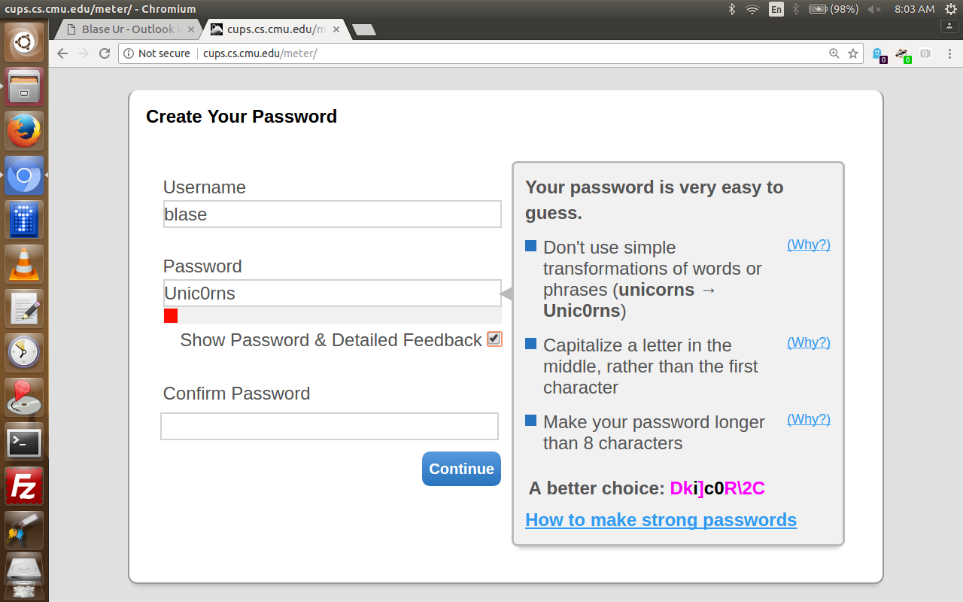
A Data-Driven Password Meter: Explanations
Unic0rns
21 characteristics
Weightings determined with regression
Blase Ur, Felicia Alfieri, Maung Aung, Lujo Bauer, Nicolas Christin, Jessica Colnago, Lorrie Faith Cranor, Henry Dixon, Pardis Emami Naeini, Hana Habib, Noah Johnson, William Melicher. Development and Evaluation of a Data-Driven Password Meter. In Proc. CHI, 2017.

Slide 38
Business Applications

Slide 39
Password Insights in Organizations
Minimum requirements: Composition policy or minimum score?
How rich should the feedback be?
How customized should scoring be to your organization?
Advice: Don’t mandate password expiration; strongly encourage unique passwords
Advice: Encourage or mandate two-factor auth (2FA)
Looking forward: WebAuthn / fewer passwords in some cases
Miranda Wei, Maximilian Golla, Blase Ur. The Password Doesn't Fall Far: How Service Influences Password Choice. In Proceedings of the Who Are You?! Adventures in Authentication Workshop (WAY), 2018.

